Slide 1
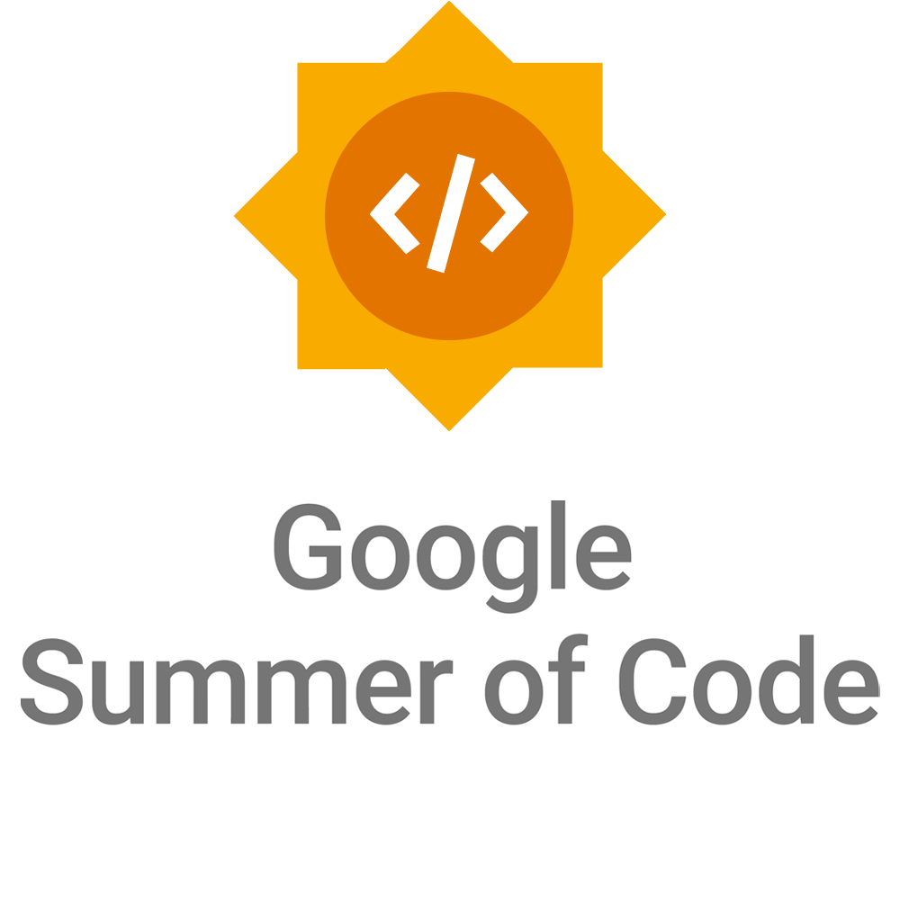

Slide 2
What is open source?
Computer software where the source code is distributed under an open source license that allows anyone to study, change, improve and distribute the software.
Promotes collaboration
Community of dedicated developers

Slide 3
What is Google Summer of Code?
Google Summer of Code (GSoC) is an online, international program designed to encourage new contributors to participate in open source software development under the guidance of mentors from the open source community.

Slide 4
About GSoC
GSoC is a global program focused on bringing more contributors into open source software development.
The program is open to students and to beginners in open source that are 18 years and older.
Contributors work on small sized projects (~90 hours), medium sized projects (~175 hours) or large projects (~350 hours).
The standard coding period is 12 weeks, however, contributors can extend their project to a max of 22 weeks with approval from their mentor. For the small sized projects, the coding period is 10-12 weeks.
Contributors work with an open source organization under the guidance of mentors while earning a stipend for successfully completing their project.

Slide 5


Goals
of the Program
  Introduce new contributors to open source software development.
  Help open source projects bring in new, excited developers who stay involved in their communities after the program ends.
  Give contributors exposure to real-world software development scenarios (testing, version control, software licensing, distributed development, etc.).
  Create more open source code for all to use.

Slide 6
How does GSoC work?
Open source software projects apply to be mentor organizations
Google chooses the organizations to participate (168 in 2023)
Contributors submit project proposals to mentor organizations
Mentor organizations choose the contributors they’d like to accept
Contributors are paired with a mentor to help them throughout their project
Coding begins! Contributors work on their project under the guidance of their mentor over 12 weeks (possible extensions available)

Slide 7
Frequently
Asked
Questions
How much time do I need to spend on the project?
There are three project sizes: ~90 hours, ~175 hours, and ~350 hours. The standard coding period is 12 weeks, however with mentor agreement you can extend the period to a max of 22 weeks. Some folks will spend more time and others a bit less.
I’m new to open source, can I participate?
Yes, GSoC is open to all newcomers 18 years and older. As long as you are excited and ready to learn from your mentors and have some level of programming experience you can succeed in GSoC.

Slide 8
Evaluations
Contributors must pass two (2) evaluations
Contributors who pass each evaluation are paid a stipend for their work
At the conclusion of GSoC, Contributors submit the code they’ve written for their project for everyone to see and use!

Slide 9
Eligibility
Over 18 upon registration for program
Beginner contributor to open source or a student
Eligible to work in the country in which you will reside during the coding period
Not a resident of a US embargoed country
Not previously accepted into GSoC more than once

Slide 10
2024 Program Timeline
Jan 22 - Feb 06
Organization applications open
Brief description of milestone goes here. Feel free to add emphasis copy when needed.
March 18 - April 02
GSoC Contributors submit their proposals
Brief description of milestone goes here. Feel free to add emphasis copy when needed.
May 01 - 26 Community bonding period with orgs
Brief description of milestone goes here. Feel free to add emphasis copy when needed.
September 03
Successful GSoC Contributor projects are announced
(for standard 12 week projects)
Brief description of milestone goes here. Feel free to add emphasis copy when needed.
Jan | Feb | Mar | Apr | May | Jun | Jul | Aug | Sep | Oct | Nov | Dec
February 21
Accepted GSoC organizations announced
Brief description of milestone goes hee. Feel free to add emphasis copy when needed.
May 01
Accepted GSoC Contributors are announced
May 27 - August 26
GSoC Contributors code the summer away
Brief description of milestone goes here. Feel free to add emphasis copy when needed.
November 04
Final submission deadline for extended projects
Brief description of milestone goes here. Feel free to add emphasis copy when needed.

Slide 11
Google Summer of Code Statistics, since 2005…
Over 20,000+ participants from 116 countries have been accepted into GSoC
Over 19,000 mentors from 133 countries
800+ open source mentoring organizations
Over 44 million lines of code have been produced

Slide 12
Useful links
Program Site: http://g.co/gsoc
GSoC Contributor Guide: http://g.co/gsoc/resources/guide
Google Open Source Blog: https://opensource.googleblog.com/
Contact GSoC: gsoc-support@google.com

Slide 13
Questions?

